Slide 1
PULMONARY CONSIDERATIONS AND COMPLICATIONS IN NEUROSURGERY

Slide 2
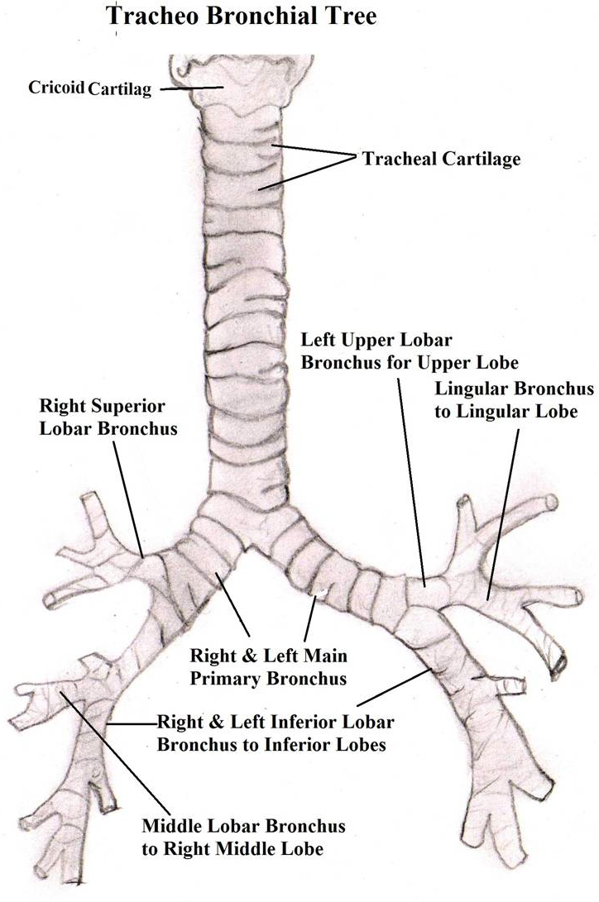
Anatomy
Tracheobronchial tree
  Dependent parts
    Posterior and Superior Segments of Right and Left Lower lobes
    Posterior Segment of Right Upper Lobe
  Right main bronchus in direct alignment with trachea
www.indianchestsociety.in

Slide 3
Anatomy
Vascular Supply
  Pulmonary circulation
    Low pressure (25/8 mm Hg)
    Filter for micro emboli
  Bronchial circulation
    Small normal physiological shunt
  Dual circulation reduces incidence of infarction

Slide 4
Anatomy
Innervation
  Afferent
    Myelinated A fibers provide stretch feedback
    Unmyelinated C fibers respond to chemical stimulation (e.g. bradykinnin)
  Efferent
    Sympathetic – vasoconstriction and mucus secretion
    Parasympathetic -- bronchoconstriction and mucus secretion

Slide 5
Physiology
Oxygen transfer is perfusion (Q) limited
  Normal alveolar-arterial PO₂ gradient = 10 mmHg [150 – (PaCO₂ /0.8)- PaO₂ ]
CO₂ transfer is Ventilation (V) dependent
V/Q mismatch results in
  ↓ed PaO₂
  ↑ed PaCO₂ – may be corrected by hyperventilation

Slide 6
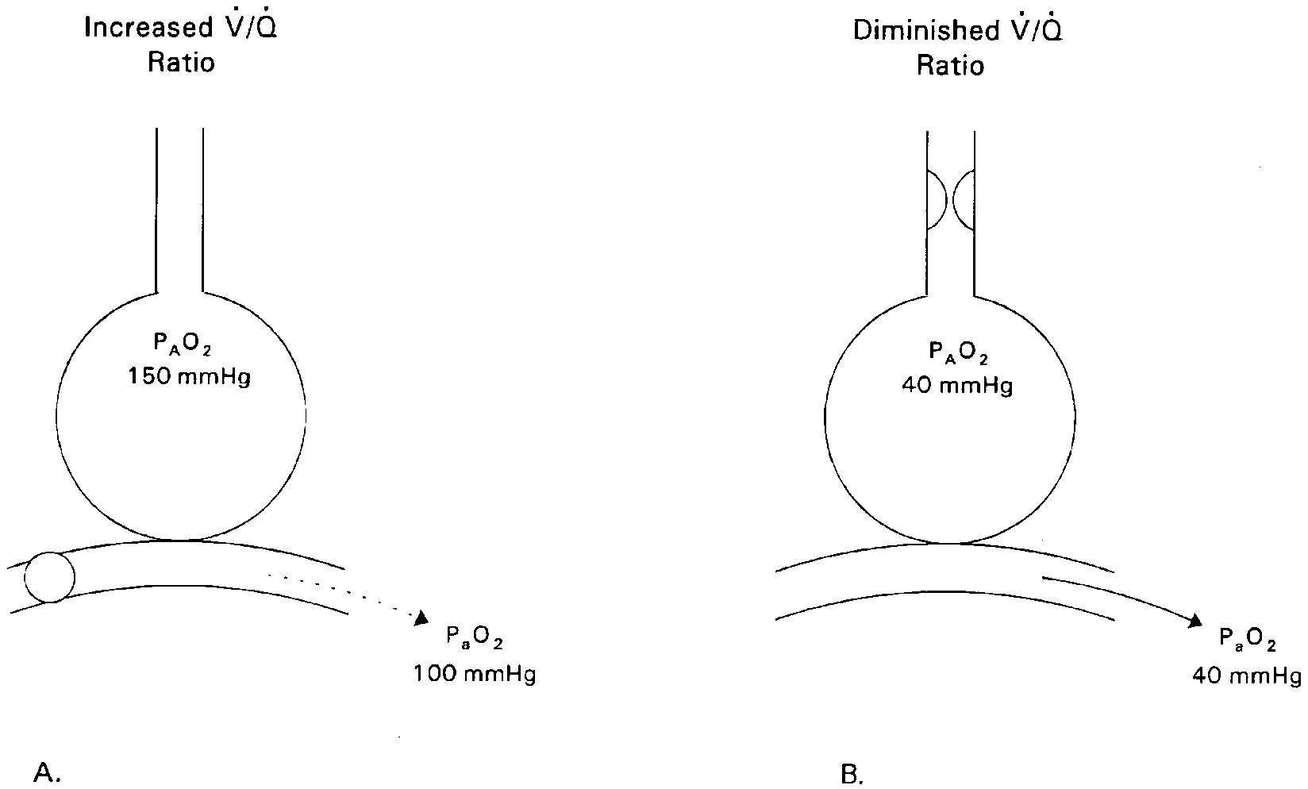
Physiology
Ventilation Perfusion Mismatch
Mucus plug
Embolus
Correctable with 100% O₂
Right to Left Shunt
Does not respond to 100% O₂

Slide 7
Physiology
Dead space -to -Tidal Volume (Vd/Vt) ratio = (PaCO₂ – PECO₂)/PaCO₂ = 0.2 - 0.3
  ↑ed Vd/Vt indicates ventilator dependence
  Tracheostomy reduces Vd/Vt
Oxygen delivery optimized by maintaining
  PaO₂ 90 – 100 mmHg
  Hb >10g/dL

Slide 8
Physiology
Control of Breathing
  Rhythm and Pattern Generator
    DRG and VRG located in medulla
  Pneumotaxic center
    Pons
    Inspiratory cut off
  Chemoreceptors
    Central (near medulla) : CSF pH and PaCO₂
    Peripheral (Carotid and aortic bodies) : O₂ delivery
  Mechanoreceptors (feedback and irritant)

Slide 9
Physiology
Breathing Patterns:
Central Alveolar Hypoventilation
  Slow and shallow; regular
  Insult to brainstem
Ataxic Respiration:
  Slow and irregular
  Injury to medulla/caudal pons

Slide 10
Physiology
BREATHING PATTERNS:
  Apneustic Respiration:
    Extended inspiration
    Injury to pons
  Central Neurogenic Hyperventilation
    Rapid and regular
    Injury to rostral pons /midbrain
    Raised ICP

Slide 11
Physiology
BREATHING PATTERNS:
  Cheyne Stokes Respiration
    Regularly irregular
    Cerebral /diencephalic dysfunction
  Others
    Kussmaul respiration (acidosis)
    Central Hypoventilation due to drug over dosage

Slide 12
Excellence in Pulmonary Care
Maintenance of airway
Adequate alveolar ventilation
Appropriate oxygenation

Slide 13
AIRWAY MAINTENANCE
Intact Gag reflex does not confirm the ability of the patient to ---
    Cough
    Sigh
    Clear secretions effectively
Head and Upper Spine injury/ Unconscious patients have risk of:-
  Aspiration
  Atelectasis
  Hypoventilation

Slide 14
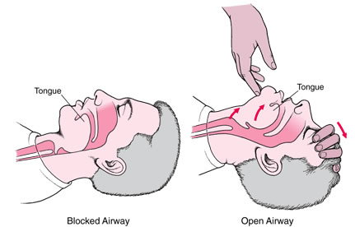
AIRWAY MAINTENANCE
Tongue fall is a common problem in supine patients
“Sniffing position”
is a temporizing
measure
www.cardiopulmonaryresuscitation.net

Slide 15
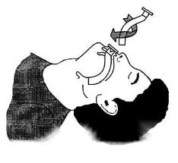
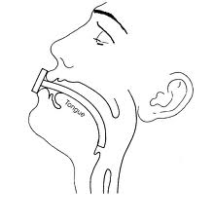
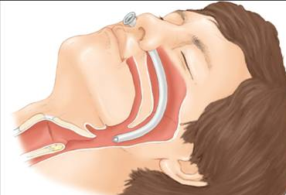
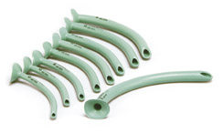
AIRWAY MAINTENANCE
Airway keeps tongue anterior
  May stimulate gag
Nasopharyngeal airway
  Bypasses tongue mechanism
  Adequate size to be used
  (e.g. Size 34 or more for 70 kg adult)

Slide 16
AIRWAY MAINTENANCE
Endotracheal Intubation
INDICATIONS:
Airway protection
  CNS Depression
  Risk of Aspiration
  Procedures (e.g. bronchoscopy)
  Acute Massive Hemoptysis
Respiratory acidosis (PaCO₂ > 60 m Hg)
  CNS depression
  Increased work of breathing (RR > 40 or < 6/min)
Hypoxia refractory to supplemental oxygen (PaO₂ <55 m Hg)
  ARDS
  Severe pneumonia
Intentional Hyperventilation
  Reduction of cerebral edema
  Reduction of ICP
* Pontoppidan H, Geffin B, Lowenstein E. Acute respiratory failure in the adult. N Engl J Med. 1972 Oct 12;287(15):743-52. .

Slide 17
AIRWAY MAINTENANCE
Endotracheal Intubation
Pre intubation 100% O₂ mask ventilation for 3- 5 mins
Size of endotracheal tube :
  ≥8 mm for adult male; 7.5 mm for female
  Selection of appropriate size to avoid pressure necrosis
Route of intubation
  Oral
    Emergency
    Allows Larger tube – work of breathing reduced
  Nasal
    Cervical spine injuries
    Contraindicated in base of skull injuries

Slide 18
AIRWAY MAINTENANCE
Endotracheal Intubation
Distal end of tube should be 20 -22 cm from teeth.
Confirmation of tube position
  Prominent breath sounds over both lung fields
  Rise in Oxygen saturation
  Condensation mist on inner tube lining
Cuff pressure ≤25 mm Hg (smaller tubes require higher cuff pressure).

Slide 19
AIRWAY MAINTENANCE
Endotracheal Intubation
Complications
Acute
  Oral/nasal trauma
  Vocal cord tear
  Tracheal perforation (pneumothorax/pneumomediastinum)
  Accidental intubation of right main bronchus
    Left lung collapse
Long term
  Tube block
  Cuff site necrosis
  Hoarseness
  Tracheal stenosis
  Tracheomalacia
  Tracheal colonization (acinetobacter , pseudomonas)
  Cuff leak

Slide 20
AIRWAY MAINTENANCE
Endotracheal Intubation
Extubation
  Patient Weaned off from ventilation
  Purpose of intubation achieved
Preferably in morning
Stop Sedation/ tube feeding
Prior chest physiotherapy; Upright position
Suctioning of endotracheal /pharyngeal secretions before deflation of balloon
O₂ by mask/nasal prong after extubation
Observation for 6 – 24 hrs

Slide 21
AIRWAY MAINTENANCE
Tracheostomy
Indications :
  Prolonged translaryngeal intubation (to prevent airway damage)
  Frequent suctioning and secretion removal (to allow easy access to the lower airway )
  Prolonged mechanical ventilation or oxygenation support (to provide a stable airway)

Slide 22
AIRWAY MAINTENANCE
Tracheostomy
ADVATAGES :
Improved patient comfort
Less need for sedation
Lower work of breathing
Improved patient safety
Improved oral hygiene
Oral intake more likely
Earlier ability to speak
Better long-term laryngeal
function
Faster weaning from mechanical Ventilation
Lower risk of ventilator-associated pneumonia
Lower mortality
Shorter intensive care unit and hospital stay

Slide 23
AIRWAY MAINTENANCE
Tracheostomy : When ?
Tracheostomy to be performed in 3-5 days in patients expected to require prolonged ventilation (~ 7 – 14 days)
    Severe head injury
    Brainstem dysfunction
    Low GCS
    Spinal cord injury at or above C4
Most of laryngeal damage occurs in first 3 days of translaryngeal intubation
    Early tracheostomy promotes healing
Durbin CG Jr. Tracheostomy: why, when, and how? Respir Care. 2010 Aug;55(8):1056-68
Durbin CG Jr et al . Should tracheostomy be performed as early as 72 hours in patients requiring prolonged mechanical ventilation? Respir Care. 2010 Jan;55(1):76-87

Slide 24
AIRWAY MAINTENANCE
Tracheostomy
Benefits of early tracheostomy
  Improved patient comfort and safety
  Faster weaning - - shorter ICU/Hospital stay
  Reduced incidence of VAP
Intubation continued for longer in children
  Concern for growing airway
  Consequences of prolonged intubation are less severe

Slide 25
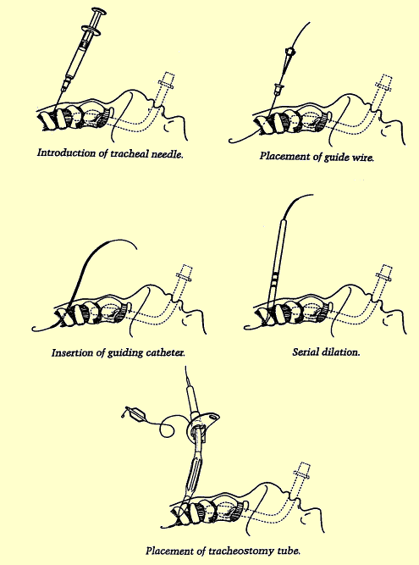
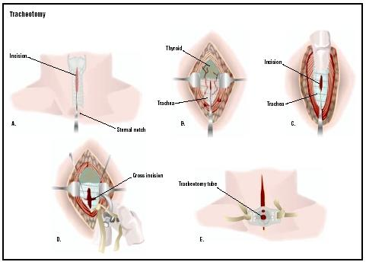
AIRWAY MAINTENANCE
Tracheostomy : How?
Open Surgical
  At the level of 2nd – 3rd tracheal rings
Percutaneous Dilation Technique : Ultrasound / Fibreoptic Bronchoscopy for precision
www.surgeryencyclopedia.com
www.gwicu.com

Slide 26
AIRWAY MAINTENANCE
Tracheostomy : How?
Open Surgical
  Lesser risk of false passage
  Lesser problems in decannulation /obstruction
Percutaneous Dilation Technique (PDT)
  Reduced procedure time
  Reduced wound infection
  Convenience
  Better scarring
  Lesser chances of major bleed
Durbin CG Jr. Tracheostomy: why, when, and how? Respir Care. 2010 Aug;55(8):1056-68

Slide 27
AIRWAY MAINTENANCE
Tracheostomy : How?
Country | Routine use of Percutaneous Tracheostomy Technique (%)
France | 21
Germany | 86
Netherlands | 62
Spain | 72
Switzerland | 57
UK | 97
Durbin CG Jr. Tracheostomy: why, when, and how? Respir Care. 2010 Aug;55(8):1056-68

Slide 28
AIRWAY MAINTENANCE
Tracheostomy
Early
Bleeding
Desaturation during procedure
Hypotension
Subcutaneous emphysema (2.2%)
Aspiration pneumonia
Pneumothorax/ pneumomediastinum
Accidental decannulation (4.4%)
Delayed
Tracheal stenosis
Infection
Tracheomalacia
Tracheo –brachiocephalic fistula
Tube obstruction
Tube impaction
Complications

Slide 29
AIRWAY MAINTENANCE
Tracheostomy - Decannulation
Protocol criteria for decannulation attempt
Absence of distress and normal ABG for 5days after prolonged ventilation
Clinically stable
Hemodynamic stability
Absence of fever/sepsis
PaCO₂ < 60 mm Hg
Endoscopy to rule out > 30% stenosis
Absence of delirium
Adequate gag/swallowing
Patient able to expectorate on request
Maximum expiratory pressure ≥ 40 mm Hg
* Ceriana et al. Weaning from tracheotomy in long-term mechanically ventilated patients: feasibility of a decisional flowchart and clinical outcome. Intensive Care Med 2003;29(5):845–848.

Slide 30
AIRWAY MAINTENANCE
Tracheostomy - Decannulation
Method
Gradually downsize the tube to ≤ 6mm with cuff deflated
Partial corking followed by full corking of metallic/portex tube (cuff deflated)
Observation for at least 24 hrs
If pH > 7.35 and < 5% PaCO₂ increase then decannulate
* Ceriana et al. Weaning from tracheotomy in long-term mechanically ventilated patients: feasibility of a decisional flowchart and clinical outcome. Intensive Care Med 2003;29(5):845–848.

Slide 31
MECHANICAL VENTILATION
Indications: same as those for intubation
Appropriate mode
  Awake patients → Synchronized Intermittent Mandatory Ventilation (SIMV) with pressure support
  Perioperative management (extubation planned in 1- 2 days) → Assist Control Ventilation (ACV)
  COPD, ARDS etc → Pressure Control Ventilation (PCV)

Slide 32
MECHANICAL VENTILATION
Settings
If pH< 7.3 and PaCO₂ > 50 mm Hg
    RR 16 – 24/min
    Tidal Volume 10 -15 ml /kg
As the parameters normalize
    RR to be reduced towards 10 -12 /min and tidal volume 10 ml/kg

Slide 33
MECHANICAL VENTILATION
Increasing FIO₂
Risk of O₂ toxicity if
FIO₂ > 50% for > 48 hrs
To be applied if FIO₂ requirement is > 50%
Optimizing oxygenation
PEEP
Redistributes lung water → improves functional residual capacity
Reduced cardiac output
Risks
Barotrauma
Raised ICP (at pressures ≥ 20 cm H₂O )
Worsening in case of pneumothorax , bronchospasm

Slide 34
MECHANICAL VENTILATION
Modes
Volume Controlled (Preset Tidal Volume And Rate)
Control Mode (CMV)
Paralyzed patients
ACV
Additional Fixed volume delivered on patient effort
Post op patients
SIMV
Additional volume delivered according to patient effort
Patients who may require prolonged ventilation

Slide 35
MECHANICAL VENTILATION
Modes
Pressure Control Ventilation (PCV)
Preset flow rate and pressure
Tidal volume depends on lung compliance
Reduced risk of barotrauma
Suitable for ARDS, Asthma, Pulmonary Edema, Contusion
Pressure Support Ventilation (PSV)
Predetermined pressure delivered with each patient breath
Adjunct to SIMV
Weaning mode
Pressure Control Inverse Ratio Ventilation (PCIRV)
Inspiratory : Expiratory time ratio reversed (~4:1)
Generates endogenous PEEP
Useful in ARDS

Slide 36
MECHANICAL VENTILATION
Modes
High Frequency Ventilation
Allows adequate ventilation at lower peak airway pressures
Useful in
ARDS
Barotrauma
Bronchopleural fistula
Continuous Positive Airway Pressure (CPAP)
Constant positive pressure is applied throughout the respiratory cycle to keep alveoli open in a spontaneously breathing patient
Used for wean without having to remove the ventilator and having to connect to additional equipment like T piece.

Slide 37
MECHANICAL VENTILATION
Weaning
Preparation
Lowest levels of FiO₂ and PEEP to maintain a PaO₂ of 80 – 100 mm Hg
Candidates
Hemodynamically stable
Adequate respiratory drive (preferably alert)
PaO₂ ≥ 60 mm Hg at FiO₂ ≤ 40%
Weaning parameters
Minute ventilation < 10L/min
Vital Capacity > 10ml/kg
Vd/Vt < 0.6 (PaCO₂ – PECO₂)/PaCO₂

Slide 38
MECHANICAL VENTILATION
Weaning – Methods
T – Piece
Patient solely responsible for initiation and work of breathing
Suitable for patients on ventilation for < 3-7 days
ABG 30 mins and 2 hours after trial
pH ≥ 7.3 and increase in Pa CO₂ not > 5 mm Hg → extubate
CPAP
SIMV
Reduce rate @ 2 breaths /min every 2 hrs up to 4 breaths /min → T piece
PSV

Slide 39
COMPLICATIONS
Mechanical Ventilation
Technical
Disconnection
Electronic malfunction
Wrong settings
Bed side Ambu Bag to be ready at all times
Hemodynamic
Hypotension
Rule out pneumothorax
Responds to fluid bolus
Reduce PEEP/Tidal Volume

Slide 40
COMPLICATIONS
Mechanical Ventilation
Ventilator Associated Pneumonia (VAP)
86% of all nosocomial pneumonias
Upto 50% mortality
Acinetobacter the commonest organism
Suspicion : a new onset (<48hrs) or progressive radiographic infiltrate with at least 2 of :
Temp >38º C or < 36º C
TLC > 10000 or <5000/ml
Purulent tracheal secretions
Gas exchange degradation

Slide 41
COMPLICATIONS
Mechanical Ventilation
Ventilator Associated Pneumonia (VAP)
Culture : Endotrachaeal Aspirate,BAL
Management : Broad spectrum empirical Antibiotic (eg quinolones) with an anti pseudomonal drug(ceftazidime, imipenem, piperacillin)
Specific antibiotic after culture reports
Supportive care
Koenig SM, Truwit JD.. Ventilator-associated pneumonia: diagnosis, treatment, and prevention. Clin Microbiol Rev. 2006;19:637–57

Slide 42
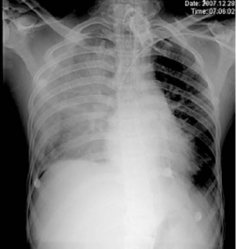
VAP

Slide 43
COMPLICATIONS
Mechanical Ventilation
Barotrauma : Associated with positive pressure ventilation. Incidence 5 -15%
Pneumothorax
Dyspnea, sharp pleuritic chest pain
Tachypnea, tachycardia
Contralateral tracheal deviation , hyper resonant percussion
Diagnosis : chest radiograph
Erect film ideal
Deep sulcus sign on supine film
Lateral decubitus film for smaller quantities of air

Slide 44
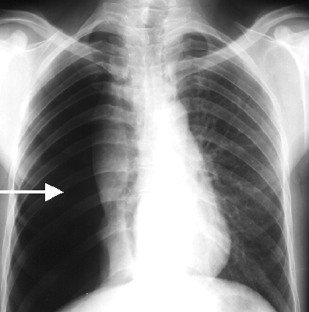
PNEUMOTHORAX

Slide 45
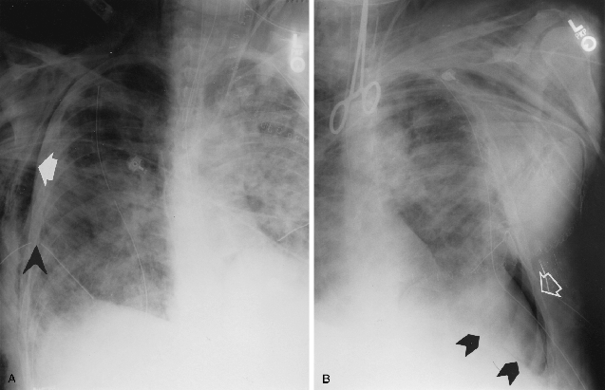
PNEUMOTHORAX
Deep Sulcus Sign

Slide 46
COMPLICATIONS
Mechanical Ventilation
Pneumothorax
  Treatment
    Emergent : 14 – 16 Gauge i/v needle in 2nd – 3rd IC space (midclavicular line)
    Definitive : Tube Thoracostomy
      To be kept in place till < 100 ml fluid drains /day
      No air leak
      Lung fully expanded
Subcutaneous and Mediastinal Emphysema are other manifestations of barotrauma

Slide 47
COMPLICATIONS
Respiratory Failure
Primary Ventilation Failure
pH < 7.3
PaCO₂ > 50 mm Hg
Alveolar – Arterial PO₂ gradient [150 – (PaCO₂ /0.8)- PaO₂ ] is normal
Central Causes: Diminished Respiratory Drive
Altered consciousness
Neuromuscular Weakness
Fatigue
Shortness of breath , tachypnea obtundation

Slide 48
COMPLICATIONS
Respiratory Failure
Primary Oxygenation Failure:
Pneumonia
Pulmonary Edema
Aspiration
Pulmonary embolism
Lung contusion
Paradoxical thoraco-abdominal respiration
Respiratory alkalosis
pH > 7.45
Decreased PaCO₂
PaO₂
Intact respiratory drive

Slide 49
COMPLICATIONS
Aspiration
Aspiration occurs in 23 – 33% neurosurgical patients
Foreign Body Aspiration (eg teeth, food particles)
Majority lodged on right side
Chemical Pneumonitis
Aspiration of as little as 25 ml of gastric content
Often does not progress to bacterial pneumonia
Anti acidity drugs promote colonization
Aspiration pneumonia
Fever (>102º F) 2-7 days after aspiration
Oral aerobic flora (Strep. pneumoniae) involved in 66-87% cases (others : bacteroides, staphylococcus, gram negative rods)

Slide 50
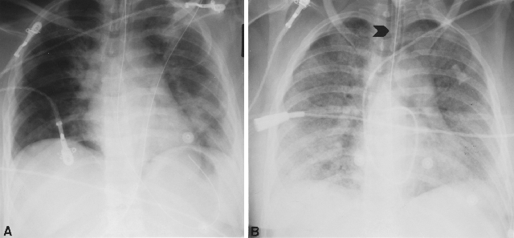
Aspiration Pneumonitis
Patchy Infiltrates
Diffuse Infiltrates

Slide 51
COMPLICATIONS
Aspiration
Treatment
  Bronchoscopy for foreign body
  Empirical antibiotics
    Penicillin group drugs for community acquired aspiration pneumonia
    Piperacillin + aminoglycoside for nosocomial aspiration
  Change as per culture reports
  Empirical corticosteroids and PEEP may not be beneficial

Slide 52
COMPLICATIONS
Atelectasis
Microatelectasis
  May not be apparent on Xray
  Intrapulmonary shunt → hypoxemia
Lobar /Panlobar Atelectasis
    Mucus plug
    Foreign body
    Intubation of main bronchus
  Collapse
  Parenchymal density on X ray; rib crowding

Slide 53
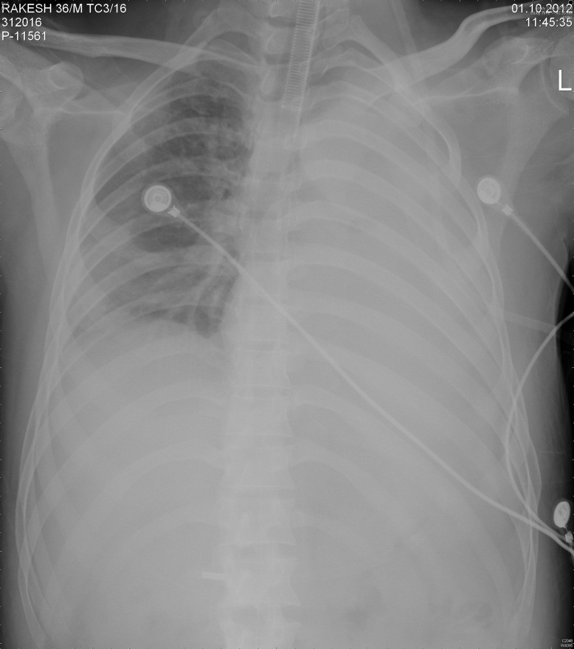
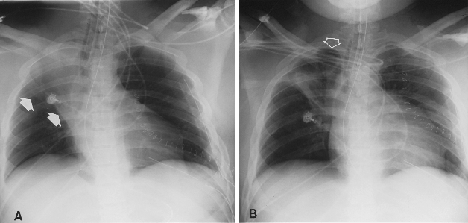
COMPLICATIONS
Atelectasis

Slide 54
COMPLICATIONS
Atelectasis – Treatment
Chest Physiotherapy
Shifting position for gravity drainage
Chest percussion
Endotracheal /Nasotracheal suction
Instillation of saline /acetylcysteine
Tube adjustment
Ventilator settings
Fibreoptic Bronchoscopy
A.D.A.M.

Slide 55
COMPLICATIONS
Pulmonary Edema
Clinically:
  Dyspnea
  Cough
  Bilateral crackles
  Occasionally wheeze
ABG
  ↓ed PaO₂
  Widened Alveolar- Arterial PO₂ Gradient
Cardiogenic
Non Cardiogenic

Slide 56
COMPLICATIONS
Pulmonary Edema
Cardiogenic
  Elevated Pulmonary Artery Wedge Pressure (> 18 mm Hg)
  Diminished cardiac output
  Jugular venous distension
  Increased systemic vascular resistance
Treatment
  Pre load reduction
    Loop diuretics (i/v furosemide 20 – 80 mg 6 hrly)
    Morphine
  Inotropes
  Ventilation with PEEP as needed

Slide 57
COMPLICATIONS
Pulmonary Edema
Non-Cardiogenic
ARDS
  Pulmonary artery wedge pressure < 18 mmHg
  No jugular venous distension
  Mortality 60 – 70%
  Treatment
    Oxygenation - mechanical ventilation with PEEP
      Pressure Control Inverse Ratio Ventilation
      High Frequency jet ventilation

Slide 58
COMPLICATIONS
Pulmonary Edema
Non-Cardiogenic
Neurogenic Pulmonary Edema
  Incidence 11 -71%
  SAH, Head Injury
  Mechanism :
    Increased Sympathetic Discharge
    Inflammatory mediators
  Treatment : Supportive

Slide 59
COMPLICATIONS
AIR EMBOLISM
Incidence 1.2 – 60%
Morbidity – mortality ~ 3%
Risk factors
Surgery in sitting position
Dehydration /blood loss causing low CVP
Diagnosis
Transesophageal Echocardiography and Doppler
Expired N2
End Tidal CO2
Treatment
Left lateral decubitus position
Aspiration of through atrial catheter
Irrigation of surgical field and sealing all portals of entry
Hemodynamic stabilization

Slide 60
COMPLICATIONS
Venous Thrombosis
Incidence of DVT 29 – 43%
Thrombo Embolism occurs in 15% cases
Risk factors
Prolonged surgery and immobilization,
Previous DVT
Malignancy
Direct lower extremity trauma
Limb weakness
Advanced age
Hypercoagulability
Clinically
Ankle, calf swelling, calf tenderness, Homan’s sign
Diagnosis
Doppler ultrasound (sensitivity 90%)

Slide 61
COMPLICATIONS
Venous Thrombosis
Treatment :
Full anticoagulation with heparin (target partial thromboplastin time of 45 to 60 seconds)
Acceptable 1- 3 weeks after surgery
Followed by Warfarin (target international normalized ratio of 2)
To be continued for 6 weeks to 3 months in uncomplicated cases

Slide 62
COMPLICATIONS
Pulmonary Embolism
Pulmonary Embolism: presentation
Tachypnea
Dyspnea
Cough
Jugular venous distension
Fever
Altered sensorium
Investigations
Po₂ of < 80 mm Hg (85%)
Right axis deviation on ECG
Infiltrates on Chest X-ray
Spiral CT (preferred)
Angiography (Gold Standard)
Radio nucleotide perfusion scan (sensitive)
Pleuritic chest pain

Slide 63
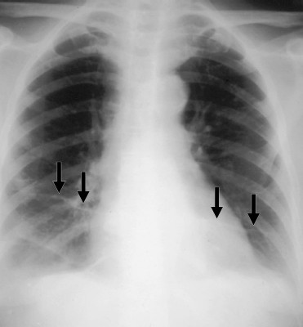
Pulmonary Thromboembolism
Bilateral pleural effusions with long linear bands of atelectasis (Fleischner lines)

Slide 64
COMPLICATIONS
Pulmonary Embolism
Treatment
Ventilatory support
Vasopressors
Full anticoagulation with heparin infusion (target partial thromboplastin time of 45 to 60 seconds) despite risk of intracranial bleed.
Pulmonary embolectomy (last resort)
i/v Heparin 5000-10000 IU bolus followed by 1000 IU/hr infusion

Slide 65
COMPLICATIONS
Pulmonary Embolism
DVT prophylaxis
  Graded Compression Stockings; Intermittent Pneumatic Compression Devices
  Low dose heparin (5000 IU twice daily)
  Low Molecular Weight Heparin
  IVC Filter
        Greenfield filter

Slide 66
COMPLICATIONS
Central Venous Access
Reported Pulmonary Complications
Catheter malposition (3.9%)
Pneumothorax (4.3%)
Catheter associated pleural/pericardial effusion (few case reports) (0.2%)
Vandoni RE, et al .Randomised comparison of complications from three different permanent central venous access systems. Swiss Med Wkly. 2009 May 30;139(21-22):313-6
Walshe C, et al . Vascular erosion by central venous catheters used for total parenteral nutrition. Intensive Care Med. 2007 Mar;33(3):534-

Slide 67
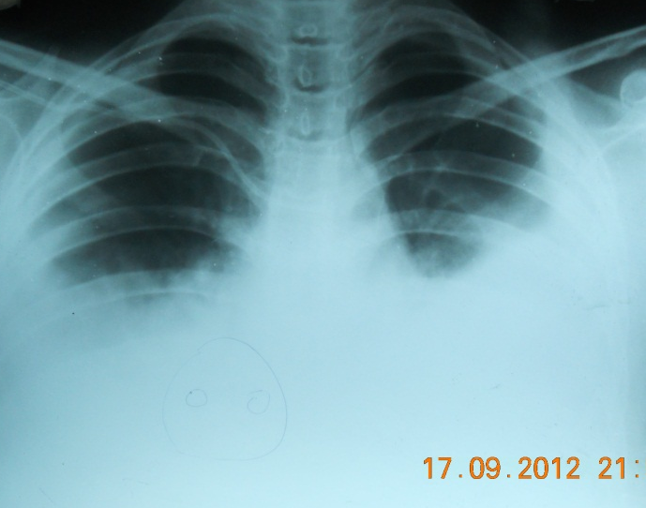
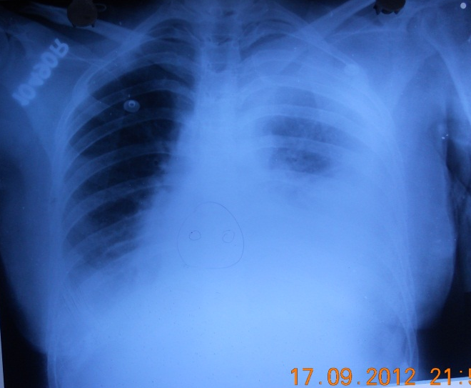
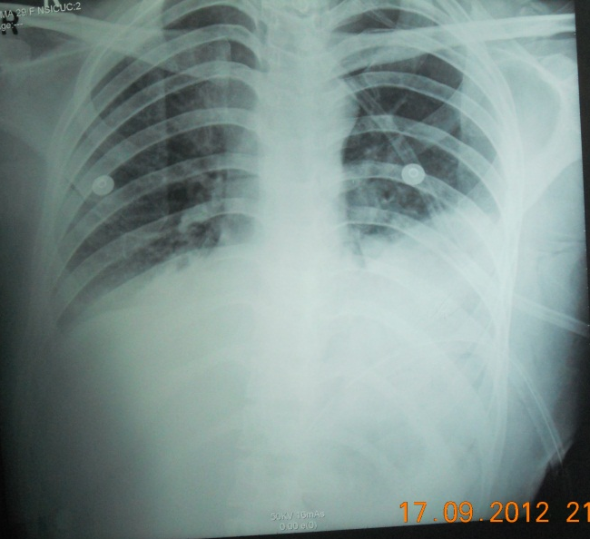
COMPLICATIONS
Central Venous Access
Central line
Chest Tube

Slide 68
CONCLUSION
Pulmonary complications are one of the most common causes of morbidity and mortality in neurosurgical patients
Many conditions require strong index of suspicion for timely diagnosis and treatment
Serial Chest X rays and ABG are indispensable
Timely intervention may help avert morbidity and mortality in many cases.

